Slide 1
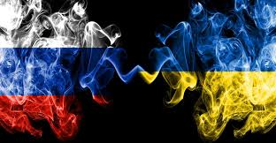
The War in Ukraine
and
The Battle for Public Opinion

Slide 2
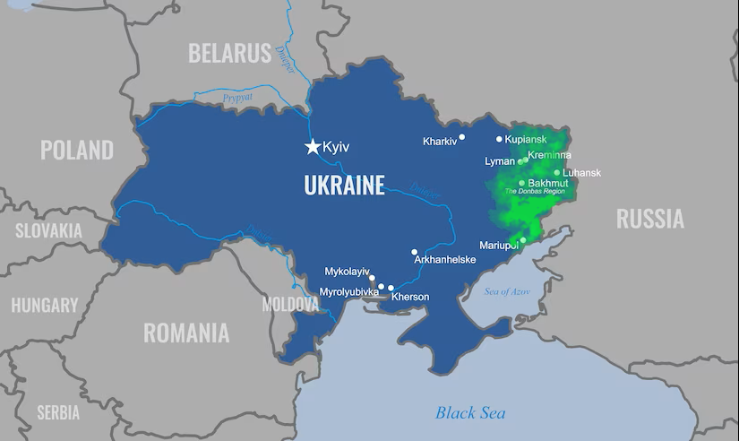
The Conflict
Many, mistakenly, think the conflict began on the 24th of February 2022 when Russia invaded Ukraine. It actually began 8 years earlier.
In late 2013 and early 2014 protests led to the ousting of Ukraine’s, pro-Russian, president Viktor Yanukovych.
Hostilities broke out in February and March of 2014. Russia invaded and annexed the Crimean Peninsula, part of Ukraine.
In April of 2014 Russian backed separatists seized government buildings in the Donbas region of Ukraine, the green area on the background map.

Slide 3
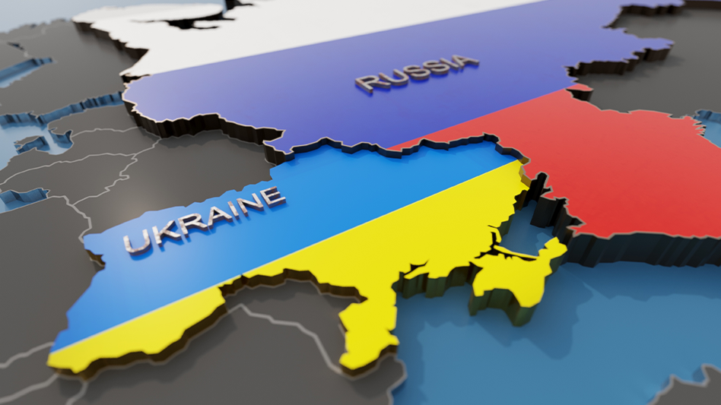
Russia’s Motivation
Putin believes Ukraine is part of Russia. He told then President Bush in 2008 that Ukraine wasn’t even a country (Baker, 2023).
Putin believes that an independent, democratic Ukraine is a threat to him and to Russia (Putin’s Motivation Behind the Attack on Ukraine | Penn Today, 2022).

Slide 4
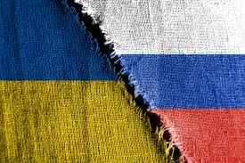
Russian Disinformation
Based on Five Pillars
Official government communications
State-funded global messaging
Cultivation of proxy sources
Weaponization of social media
Cyber-enabled disinformation
Examples
2014 Crimea
2016 US election, Brexit
2018 “The Skripal Case”
2020 COVID-19
Notes:
Examples
2014 Crimea - Russia ran a fairly effective disinformation campaign claiming that it was only invading to protect Russian citizens living in Crimea. They compared it to the US invasion of Panama in December 20th of 1989. One major difference the US left Panama in at the end of January 1990. Russia has never left Crimea.
2016 US election, Brexit - A bi-partisan report by the US Senate Select Committee on Intelligence, published 10 Nov 2020 found that the Russian government actively interfered in the 2016 US election.
Similarly The Intelligence and Security Committee of Parliament in the UK published a report in July of 2020, found that Russia actively meddled and attempted to sway the results of the Brexit referendum. "Because Russian influence operations thrive on divided audiences, the very close result of the referendum could well have been influenced by any or all of these factors. The government’s refusal to prepare then and to investigate now shows it is not prepared to handle the truth—and only the Kremlin benefits."
2018 “The Skripal Case” - In March 2018, Sergei Skripal, a British citizen who used to work as a Russian intelligence officer, and his daughter, Yulia, nearly died after coming into contact with Novichok, a military-grade nerve agent originally developed by the former Soviet Union. By the end of March 2018, more than 20 nations, including the United States, expelled 153 Russian diplomats and intelligence officers in support of the U.K. and in protest of the poisonings.
Russian officials and state-run media spread several false claims after the incident including:
Someone else did it: The United States, Ukraine, United Kingdom and exiled Russian oligarchs planned the attack.
It was not Novichok: It was a “NATO toxin,” or Skripal was smuggling chemical weapons.
The attack never happened: NATO used reports of the poisonings as a ruse to justify a budget increase, and the U.K. used them to distract from Brexit.
Three weeks after the attack, two-thirds of social media posts about it came from Kremlin-supported sources, according to 2018 analysis from the Atlantic Council’s Digital Forensic Research Lab.
2020 COVID-19 - Russia conducted a widespread disinformation campaign to foster doubts about the safety of the COVID-19 vaccines in the west.

Slide 5
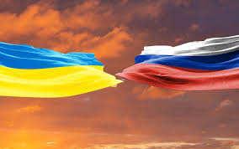
My Poll
24 Total Questions
First 5 Biographical:
Age
Gender
Education
Country of Residence
Income
Next 19 Attempted to Determine the Extent of Russian Disinformation

Slide 6
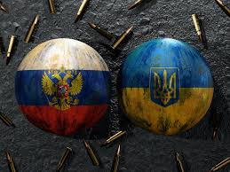
Responses
71 Total Responses
Distributed Through the Social Media Site, Reddit
First Posted on October 4th, 2023
Last Response on October 21st, 2023

Slide 7
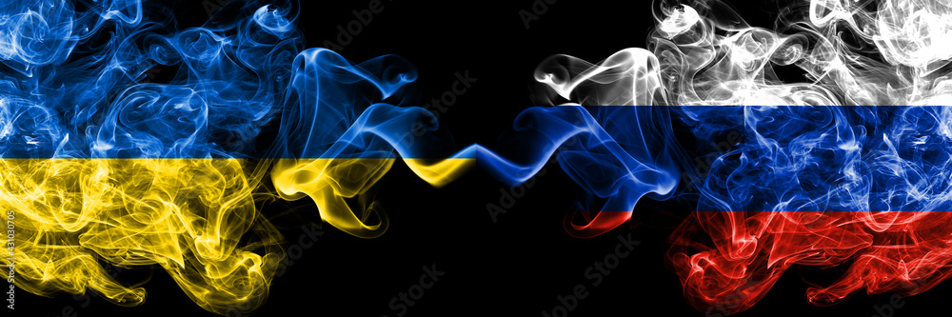
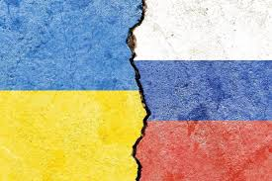
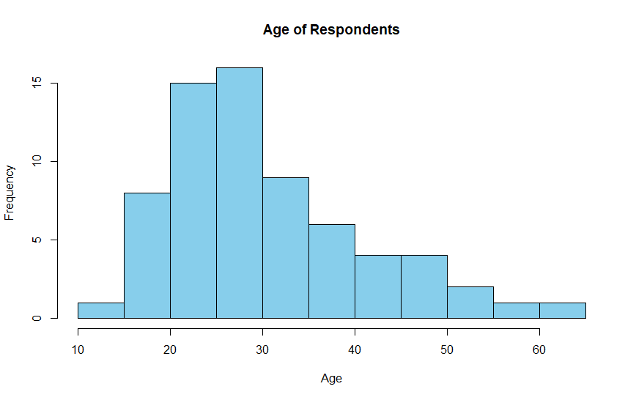
AGE
Youngest - 14
Oldest – 63
Average – 30.84
Created In SAS Studio

Slide 8
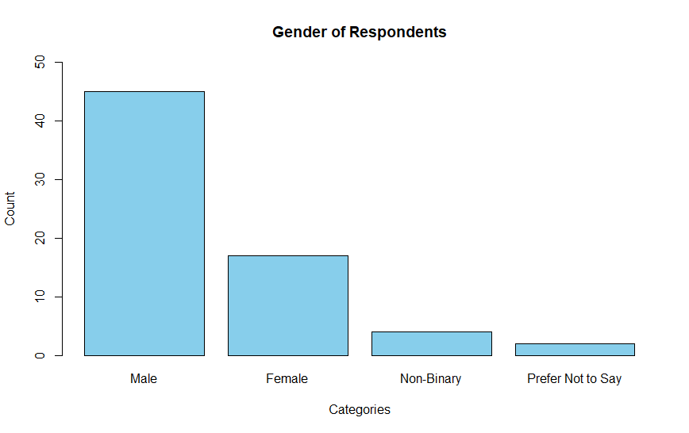
GENDER
Created In SAS Studio

Slide 9
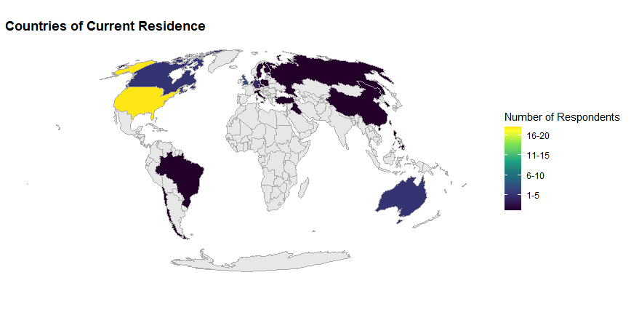
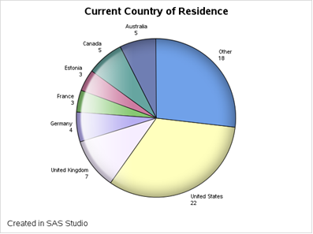
24 Different Countries
Created in R Studio

Slide 10
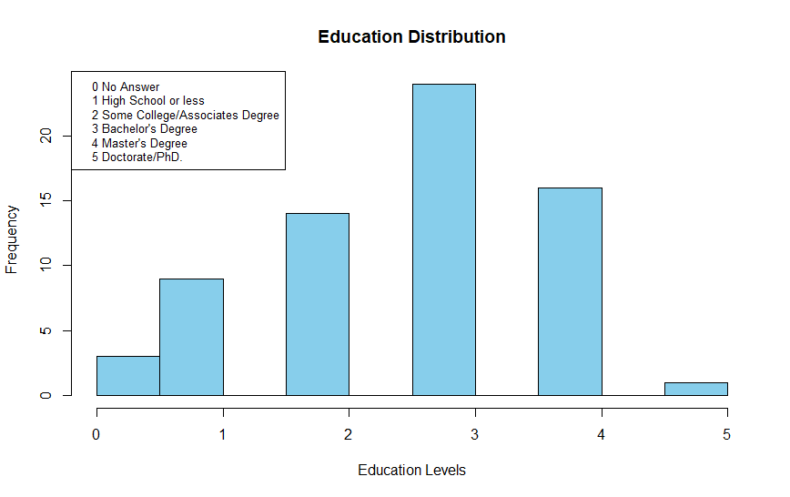
LEVEL OF EDUCATION
Created Using SAS Studio

Slide 11
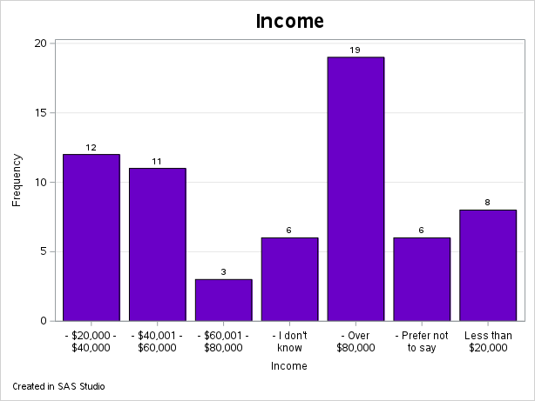
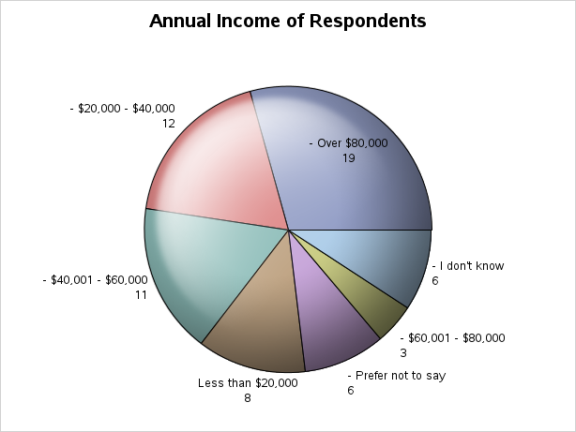
INCOME
Created In SAS Studio

Slide 12
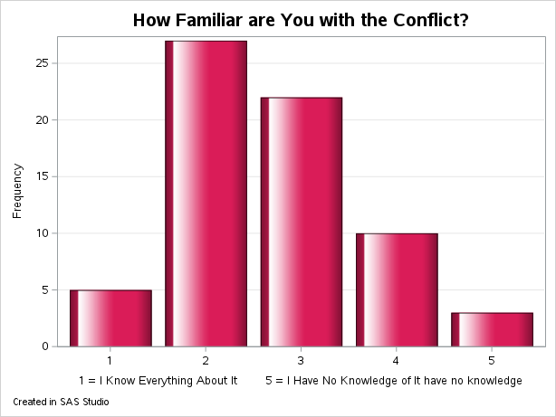
How Familiar are You with the Conflict?
On a Scale from 1-5
1 I know everything about it
5 I have no knowledge of it
67 Responses
The average response was a 2.69

Slide 13
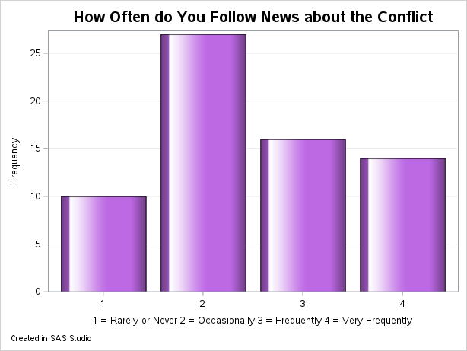
How Often do You Follow News About the Conflict?
1 Rarely or Never
2 Occasionally
3 Frequently
4 Very Frequently
68 Responses Average was 2.51

Slide 14
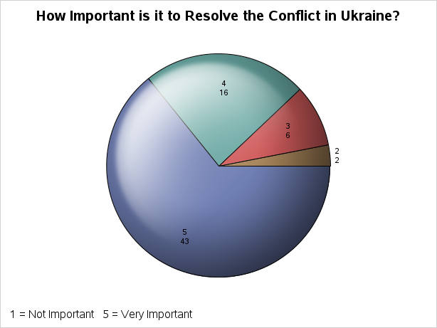
How Important is it to Resolve the Conflict?
On a Scale from 1 to 5 Where:
1 = Not Important
5 = Very Important
68 Responses
Average was 4.49
Created in SAS Studio

Slide 15
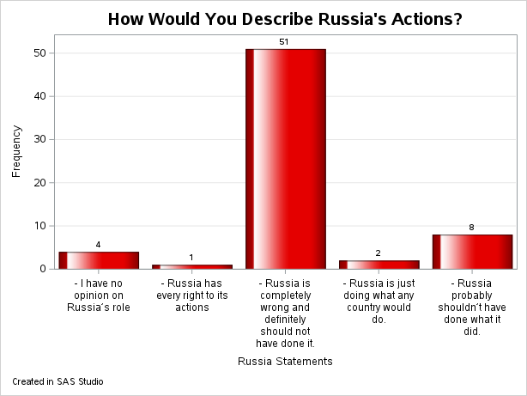
How Would You Describe Russia’s Actions
The Choices
Russia is just doing what any country would do.
Russia has every right to its actions
I have no opinion on Russia’s role
Russia probably shouldn’t have done what it did.
Russia is completely wrong and definitely should not have done it.

Slide 16
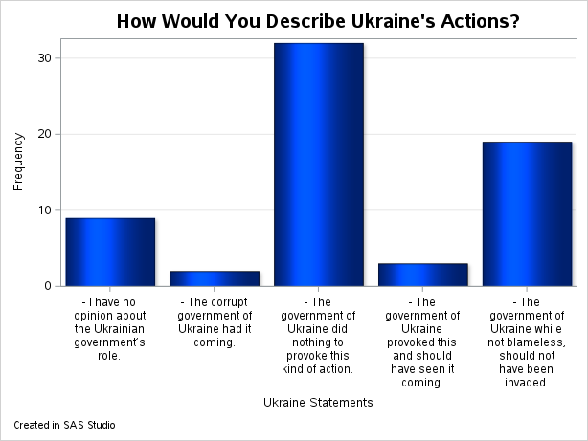
How Would You Describe Ukraine’s Actions?
The Choices
The corrupt government of Ukraine had it coming.
I have no opinion about the Ukrainian government’s role.
The government of Ukraine while not blameless, should not have been invaded.
The government of Ukraine did nothing to provoke this kind of action.

Slide 17
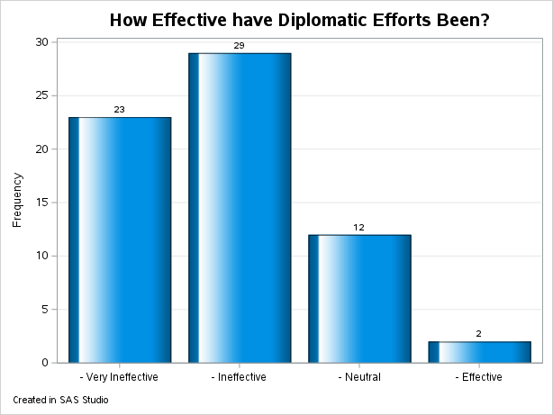
How Would You Rate the Effectiveness of Diplomacy?
The Choices
Very Ineffective
Ineffective
Neutral
Effective
Very Effective

Slide 18
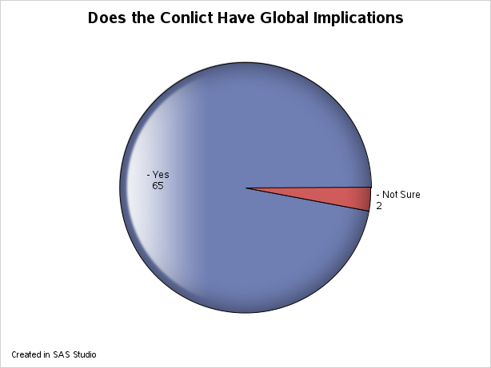
Do You Believe The Conflict has Global Implications?

Slide 19
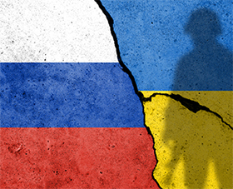
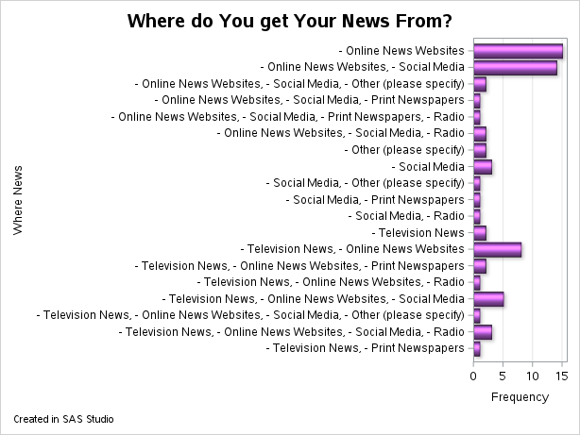
Where do You get Your Information about the Conflict?
The Choices
Television News
Online News Websites
Social Media
Print Newspapers
Radio
Other (please specify)

Slide 20
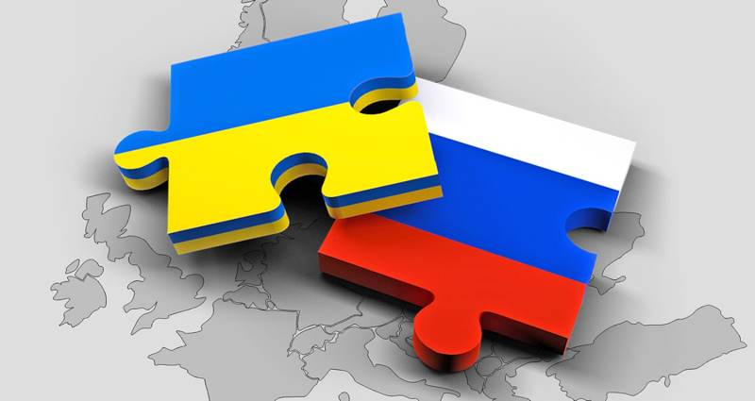
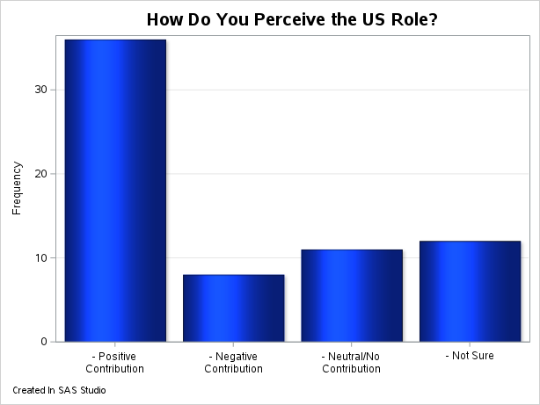
How do You Perceive the US Role
The Choices
Positive Contribution
Neutral/No Contribution
Negative Contribution
Not Sure

Slide 21
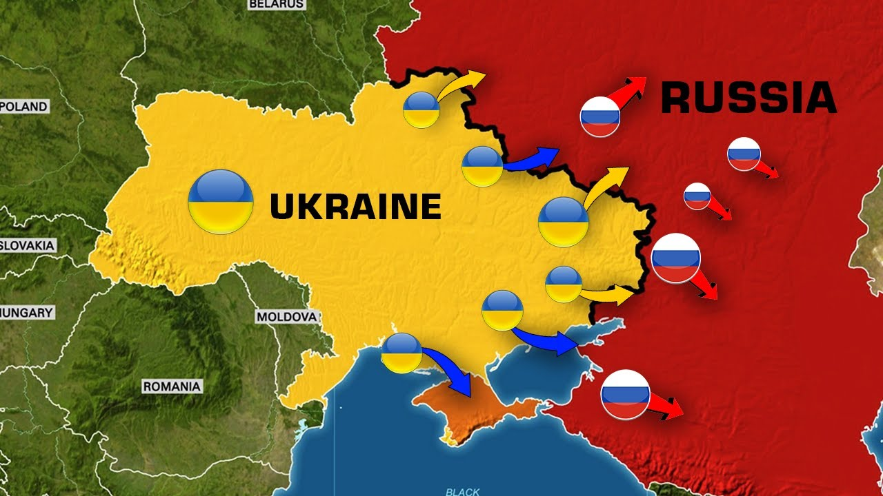
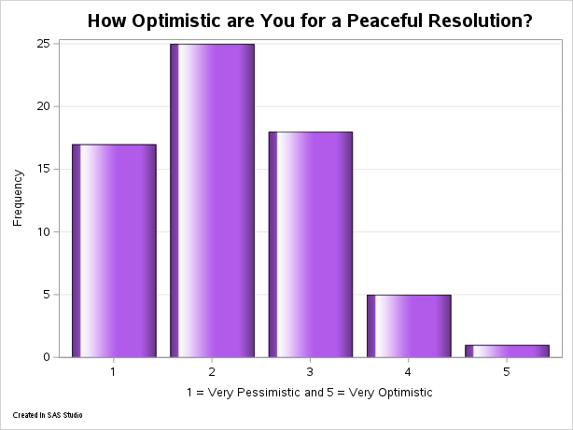
How Optimistic are You for a Peaceful Resolution?
On a Scale from 1 to 5
1 = Very Pessimistic
5 = Very Optimistic

Slide 22
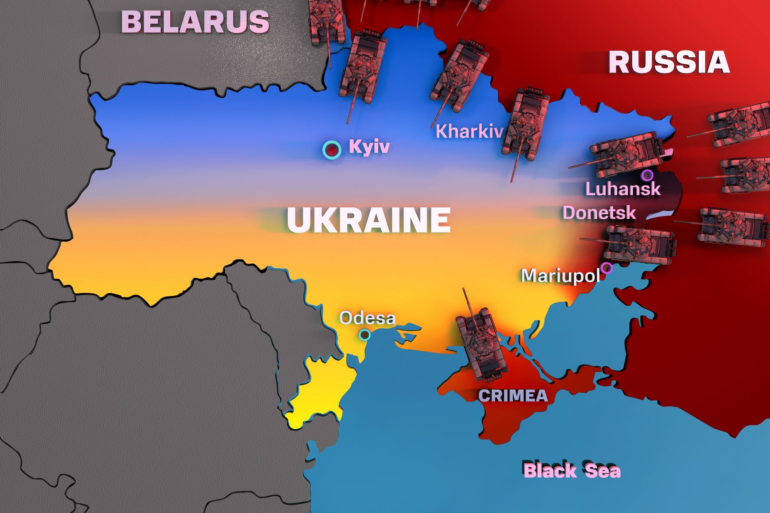
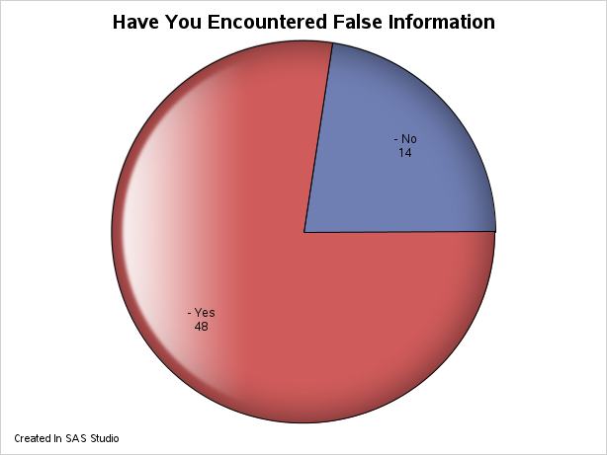
Have You Encountered any False or Misleading Information?

Slide 23
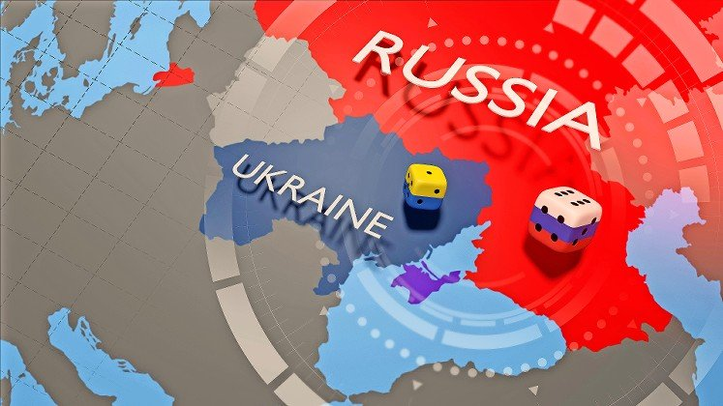
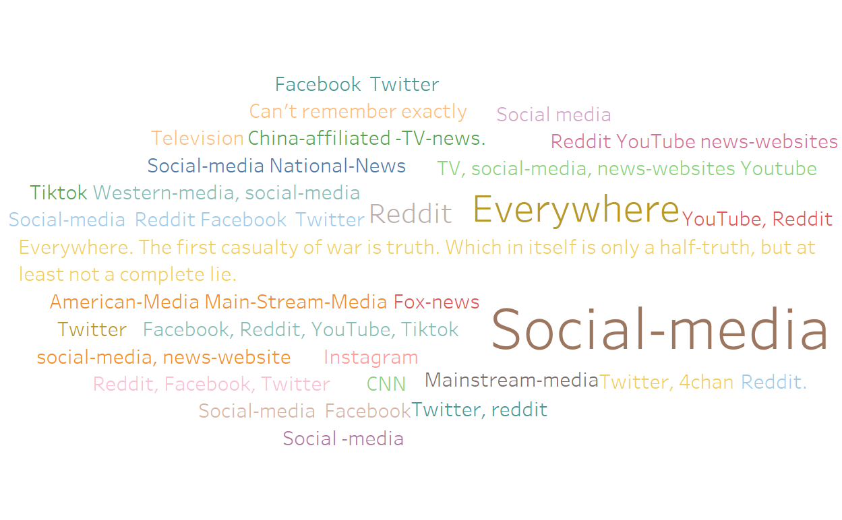
Where did You Encounter False or Misleading Information?
Created in Tableau

Slide 24
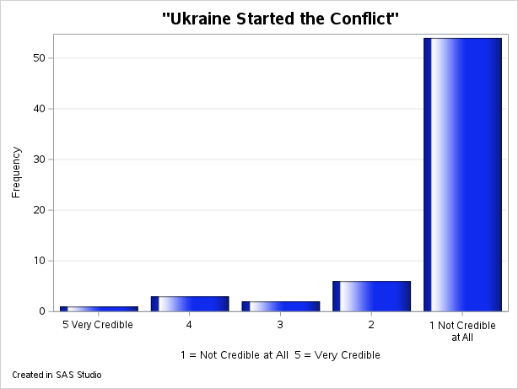
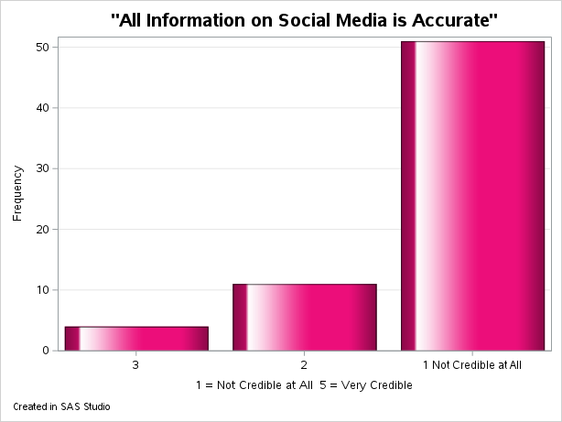
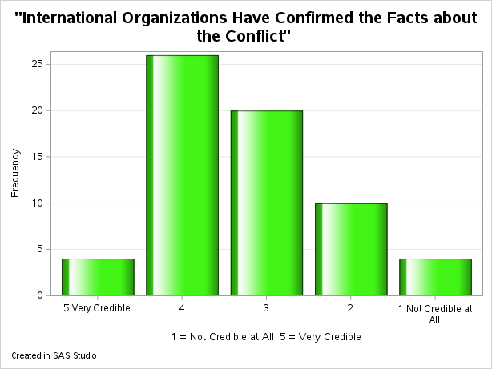
Please Rate the Credibility of the Following Statements
On a Scale from 1 to 5
1 = Not Credible at All
5 = Very Credible

Slide 25
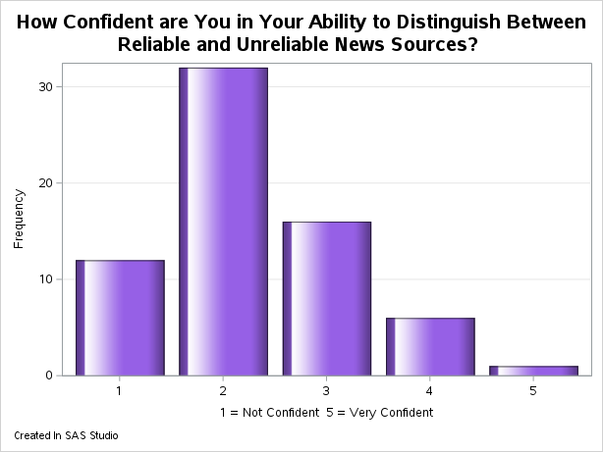
How Confident are You in Your Ability to Distinguish Between Reliable and Unreliable New Sources?
On a Scale between 1 – 5
1 = Not Confident
5 = Very Confident
67 Responses
Average was 2.28

Slide 26
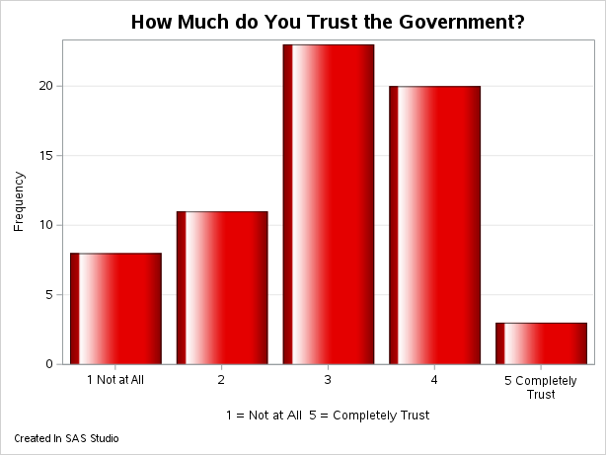
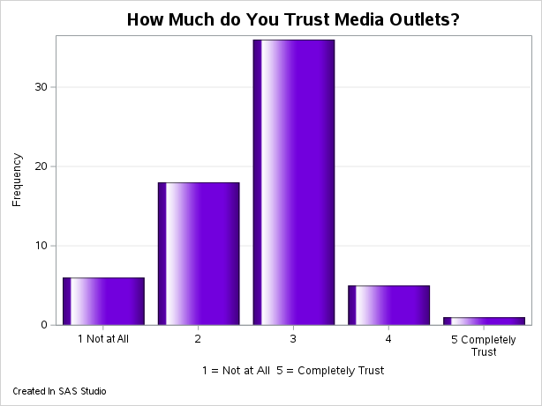
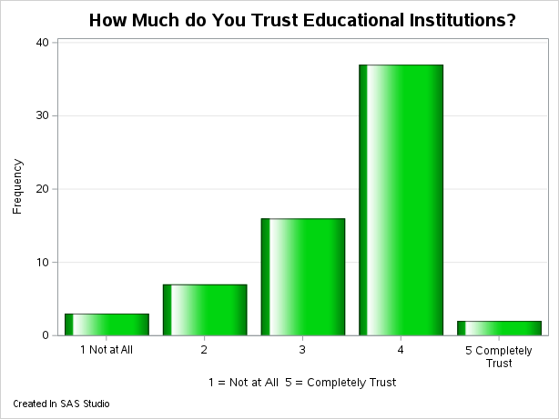
How Much do You Trust?
Government
Media Outlets
Educational Institutions
On a Scale from 1 to 5
1 = Not at All
5 = Completely Trust

Slide 27
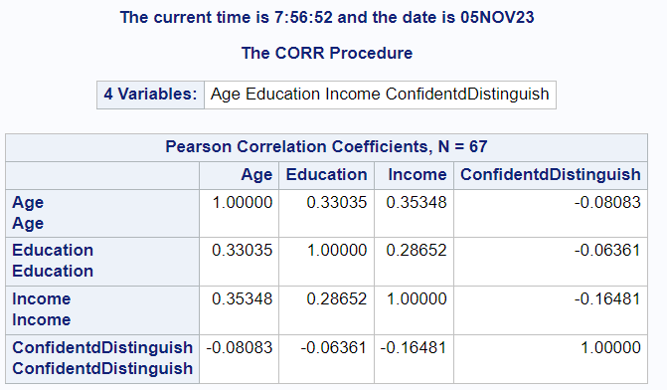
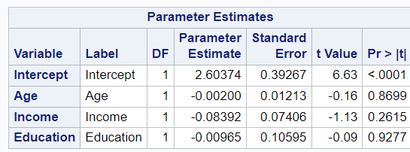
Relationships
Correlations
Any Correlation between Age, Education, Income and How confident individual are at distinguishing misinformation is weak and not statistically significant.
Created in SAS Studio
Created in SAS Studio

Slide 28
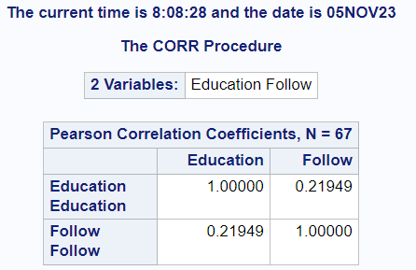
Relationships Cont.
A weak positive correlation between education and how much they follow news about the conflict
Created in SAS Studio

Slide 29
Relationships Summary
I was unable to find any correlation between variable that was greater than moderate and most were weak and not statistically significant.
Possible causes:
Poorly constructed poll
Too few responses
No correlation exists.

Slide 30
Overall Summary
The vast majority of respondents, 77%, have encountered false or misleading information about the conflict.
The leading source for disinformation is the internet (social media, internet news sources). The internet is also the largest source of information about the conflict for the respondents.
The respondents are more likely than not to trust the “Government”.
Trust in the media is split evenly between those who do and don’t.
Trust in educational institutions was the highest

Slide 31
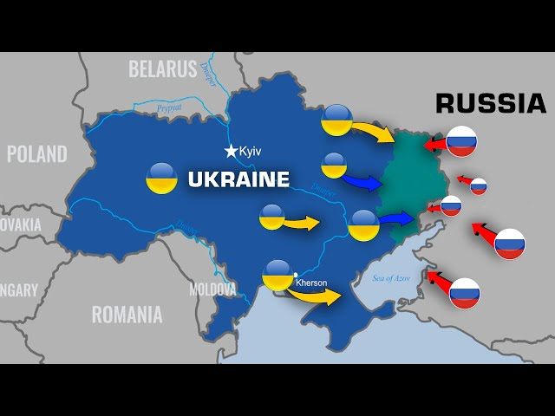
References
Baker, S. (2023, July 4). Why did Russia invade Ukraine? Experts break down Putin’s motivations and excuses for launching his war. Business Insider. https://www.businessinsider.com/why-did-russia-invade-ukraine-putin-politics-motive-2023-6
GEC Special Report: Russia’s pillars of disinformation and propaganda - United States Department of State. (2022, January 24). United States Department of State. https://www.state.gov/russias-pillars-of-disinformation-and-propaganda-report/
Paul, C. (2016, July 11). The Russian. https://www.rand.org/pubs/perspectives/PE198.html

